Slide 1

WildSentinel: Safeguarding the Human–Wildlife Interface
Biosafety Standard and Ethics - EL

Slide 2
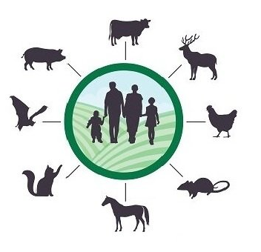
A step to save Humanity
1
Zoonotic diseases are increasing worldwide as human expansion, wildlife trade, and habitat loss push people closer to wild animals.
2
These rapid environmental changes create new pathways for dangerous pathogens to move from animals to humans.
3
Current surveillance systems react only after an outbreak begins, leading to delays in prevention and control.
4
WildSentinel aims to predict these risks early by combining ecological, environmental, and trade-based data into one unified model.

Slide 3
Literature Review
Name of the Research paper | Name of the contributors | Key Learnings | Year
Zoonotic Spillover in an Era of Rapid Deforestation & Wildlife Trafficking | O. Bajinka, H.J. Oladipo | Bajinka and Oladipo expand on the ecological drivers of spillover by demonstrating how rapid deforestation and growing wildlife trafficking networks jointly break down natural biological barriers. Their study emphasizes that human-driven habitat destruction directly increases opportunities for pathogen exchange, especially when displaced wildlife is pushed into human activity centres. This supports WildSentinel’s integration of both land-use and wildlife movement/trade patterns to capture how ecological disruption amplifies risk. | 2022
Bushmeat Hunting, Deforestation, and Prediction of Zoonotic Disease | N.D. Wolfe, P. Daszak, A.M. Kilpatrick, D.S. Burke | This study reveals how practices like bushmeat hunting combine with forest loss to create extremely high-risk spillover environments. It shows that when wildlife is directly exploited for meat, the human–animal interface becomes intense, frequent, and unpredictable, making pathogen transmission easier. The paper stresses that early prediction models must use environmental indicators such as forest loss and human proximity—both of which are central to WildSentinel’s feature engineering pipeline. | 2005
Analysis: Roles & Risks of Wildlife in Human Infectious Diseases | R. Kock, H. Caceres-Escobar | The IUCN report provides detailed evidence that wildlife in degraded or disturbed ecosystems becomes a much stronger carrier of infectious pathogens. When habitats collapse, species that thrive in disturbed ecosystems (bats, rodents, primates) expand into human zones, increasing contact rates. The study also highlights the importance of biodiversity patterns in identifying high-risk spillover zones, justifying WildSentinel’s use of species richness, host density, and distribution layers. | 2013

Slide 4
Literature Review
Name of the Research paper | Name of the contributors | Key Learnings | Year
Drivers and Consequences of Viral Zoonoses | A. Banik, S. Basu | Banik and Basu emphasize that zoonotic emergence is not solely ecological—it is heavily influenced by socio-economic behaviour, market demand, illegal wildlife trade, and poor biosafety practices. Their analysis shows that outbreaks emerge at the intersection of environmental degradation, human pressure, and wildlife exploitation. This directly supports WildSentinel’s multi-factor modelling approach, combining ecological, environmental, trade, and biosafety parameters to produce realistic spillover predictions. | 2025
A Game Theoretic Treatment of Contagion in Trade Networks | McAlister, Brunner, Galvin, Fefferman | This study shows that the structure of trade networks—including the relationships between markets, intermediaries, and distribution hubs—plays a major role in how contagion spreads across regions. Their game-theoretic modelling demonstrates that markets with high connectivity act as amplifiers of disease flow. This insight aligns with WildSentinel’s use of wildlife-trade pathways and network-inspired feature engineering, where trade volume and movement patterns significantly influence spillover probability. | 2025
Mathematically Modeling Spillover Dynamics of Emerging Zoonoses | K.P. Royce, F. Fu | Royce and Fu build mathematical models that map how pathogens move between wildlife, intermediate hosts, and humans. They show that spillover events are shaped by multi-host interactions and ecological overlaps. Their work highlights the importance of modelling indirect transmission routes—not just direct human–wildlife contact. WildSentinel adopts this perspective through multidimensional features, accounting for habitat, species density, and anthropogenic pressure. | 2019

Slide 5
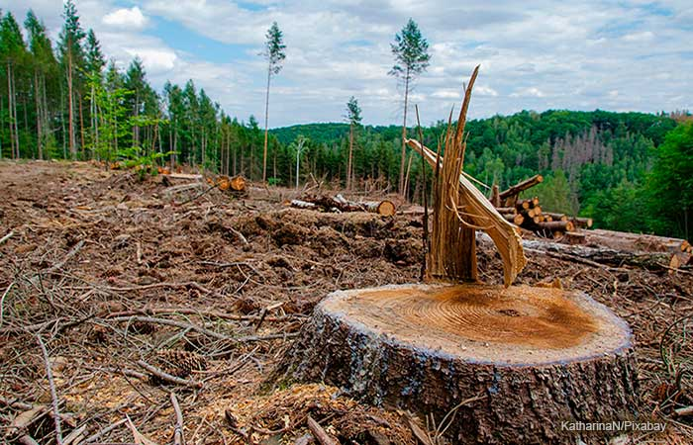
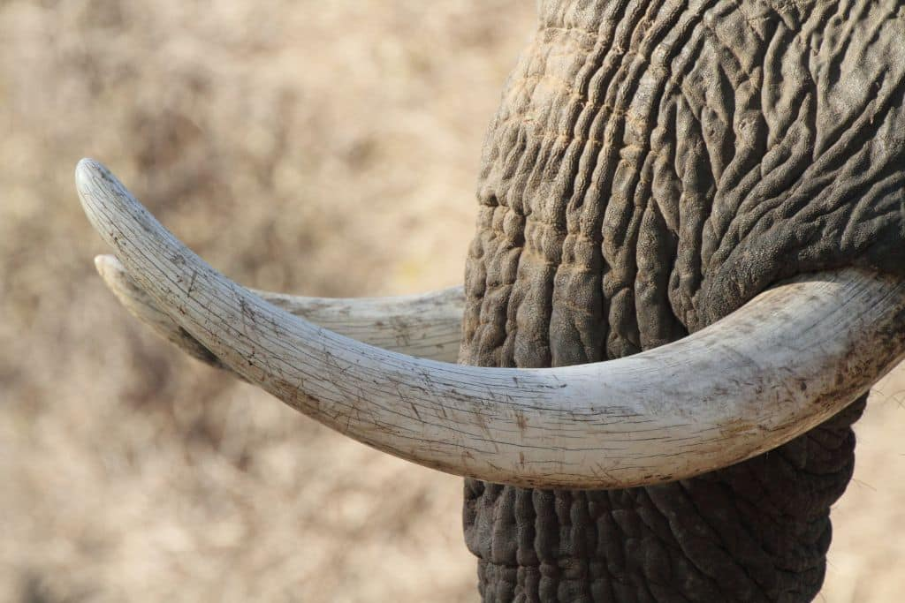
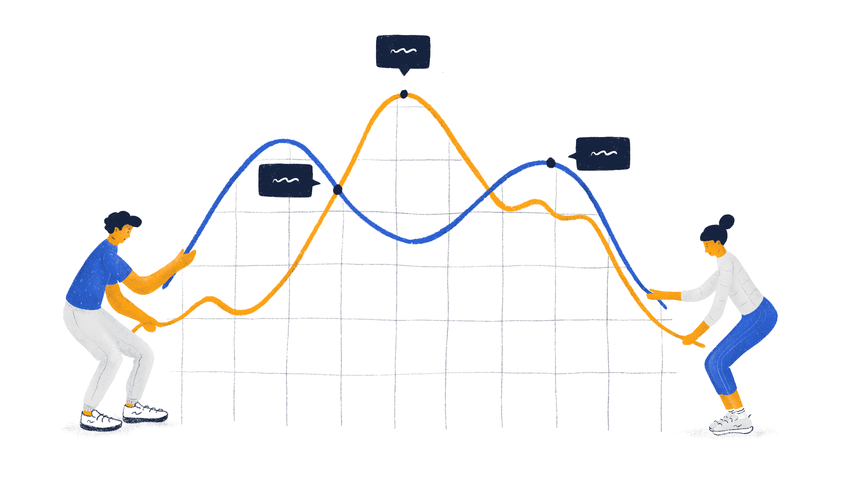
Problems
Increased Human–Wildlife Interaction Due to Rapid deforestation,
and urban expansion are pushing humans and wildlife into closer contact. This breaks natural ecological barriers and significantly elevates the risk of zoonotic spillover events.
Increased wildlife trade creates high-risk environments, such as live animal markets and long transport routes, where pathogens can easily jump between species. The absence of strict controls allows these trade networks to become major drivers of emerging diseases.
Most existing bio surveillance systems are reactive, focusing on outbreaks only after they occur. There is no unified predictive framework that integrates ecological, environmental, and trade-based data to forecast spillover risk, leaving policymakers without timely, actionable intelligence.

Slide 6

Significance of addressing the problem
The disturbances at the human–wildlife interface are emerging as a major global concern, creating serious threats not only to wildlife populations but also to human health and the stability of entire ecosystems.
Increased chances of spillover events
Unregulated wildlife trade networks
Overlap of human–wildlife habitats
Increased risks to human health
Disturbances in the entire ecosystem.
6

Slide 7
Objectives
1
The main objective of our project is to develop a predictive system that can identify regions with high risk of zoonotic spillover by integrating wildlife trade, habitat loss, species distribution, and outbreak data.
2
We aim to build a machine-learning and geospatial-based framework that analyzes these multisource datasets and generates hotspot maps, risk scores, and early-warning indicators for proactive bio surveillance.
3
Through this project, we aim to support both public health and ecological stability by enabling early detection of spillover threats, guiding better policies, and promoting safer coexistence between humans and wildlife.

Slide 8

Methodology
Data Collection: Collection of different datasets trade, species distribution, environmental changes such as habitat loss, land data, and records of past disease spillover events. This provided a broad understanding of how human activity and ecological factors interact to influence spillover risk.
Dataset Cleaning: Collected data is cleaned by removing inconsistencies, correcting spatial information, standardizing formats, and extracting meaningful environmental and interaction indicators. Using this cleaned data a master data set is created to train our model. This ensured the dataset was reliable, uniform, and ready for modelling.
Model Training: Using the master data set we are going to train a machine-learning model to estimate zoonotic spillover. We are going to use XGBoost model due to its strong performance on non linear datasets. The model learns relationships between wildlife trade, habitat overlap, species richness, and past outbreak trends. Output is a spillover probability score for each region, enabling early identification of high-risk zones

Slide 9
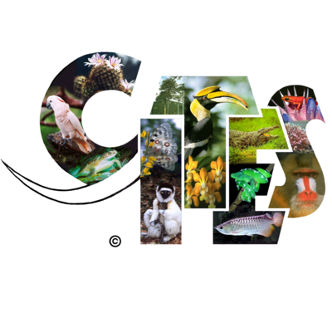



Methodology
Datasets Used:
CITES Wildlife Trade Data
Provides detailed records of international wildlife movement, including quantity, species traded, trade routes, and pressure points where human–animal contact increases due to commerce.
GBIF Species Distribution Data
Contains global species occurrence points used to identify where host animals are located, how diverse an ecosystem is, and which regions have higher potential for spillover due to species richness.
NASA MODIS Environmental Data
Offers satellite-derived information such as forest loss, vegetation index (NDVI), and land-use changes. These indicators help measure habitat degradation and human-driven ecological disturbance.
WHO Outbreak Records
Includes historical data on zoonotic disease outbreaks, helping the model learn patterns of past spillover events and validate predictions for future high-risk regions.

Slide 10
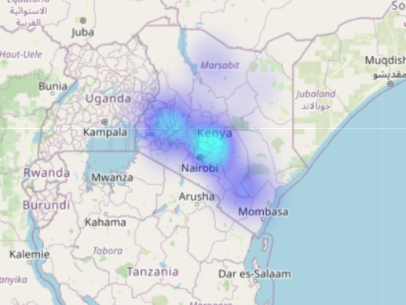
Methodology
Dashboard Overview
Interactive Risk Mapping
The dashboard displays geospatial heatmaps showing spillover risk across different regions, helping users quickly identify emerging hotspots with help of leaflet js.
Scenario Simulation View
The dashboard allows comparison of different intervention scenarios—like reduced trade or increased forest cover—to observe changes in predicted risk levels.
Time-Based Trend Analysis
Year-wise and region-wise trends show how spillover risk evolves over time, enabling policymakers and researchers to monitor patterns and plan early interventions.

Slide 11
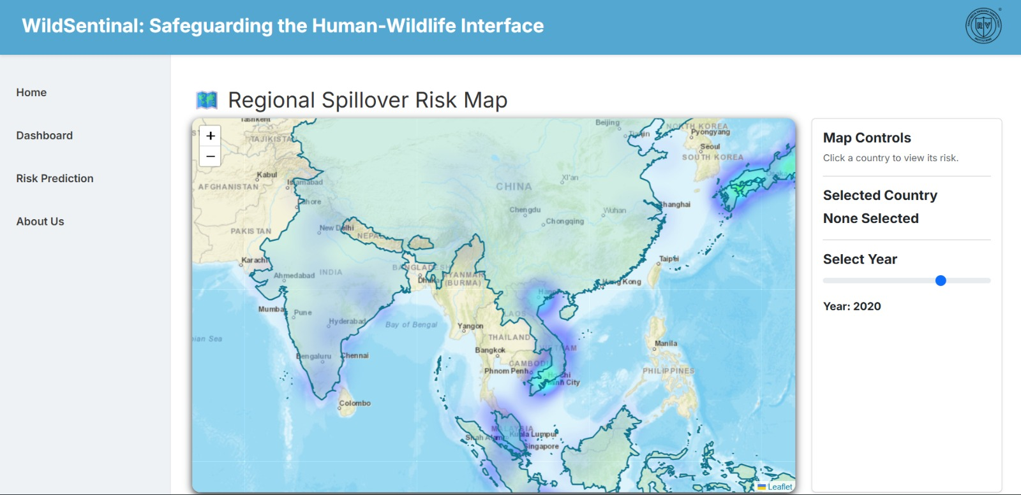
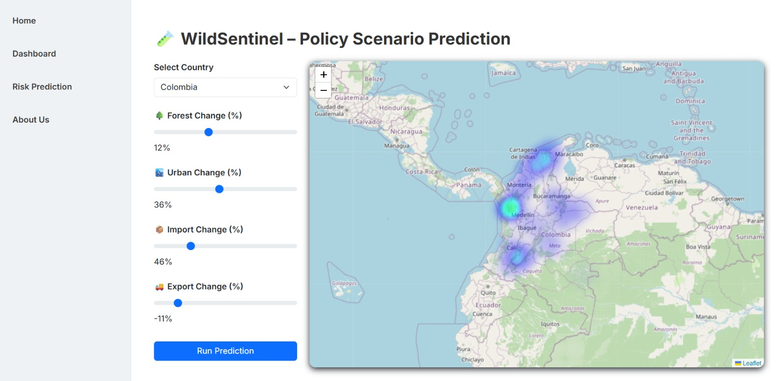
Outcomes
Developed a Working Predictive Model
Successfully built and trained a machine-learning model that identifies regions with high zoonotic spillover risk using ecological, environmental, and human-activity indicators.
Generated Accurate Hotspot Maps
Created geospatial heatmaps that clearly highlight high-risk zones, validating the system against historical spillover and outbreak patterns.
Built an Interactive Dashboard
Designed a functional dashboard that visualizes risk scores, trend changes, and scenario outcomes, enabling easy interpretation for researchers and policymakers.
Conducted Intervention Simulations
Ran multiple simulation scenarios (e.g., reduced trade, increased forest cover) and observed measurable reductions in predicted spillover risk.

Slide 12
Conclusion
WildSentinel shows that zoonotic spillover risk can be predicted early by integrating wildlife trade, habitat loss, biodiversity, and outbreak data into a unified analytical framework.
The project applies a combined geospatial and machine-learning methodology, enabling the system to capture real-world interactions between humans, wildlife, and ecosystems more accurately than traditional reactive models.
1.
2.
The ML model demonstrates strong predictive ability on unseen data, successfully identifying historical hotspots and highlighting new high-risk zones, validating its use as an early-warning tool.
3.
4.
Simulation results reveal that reducing illegal wildlife trade or restoring forest cover can substantially lower predicted spillover risk, showing WildSentinel’s value for policy and bio surveillance planning.
Overall, WildSentinel provides a scalable, data-driven decision-support framework grounded in the One Health approach, helping strengthen global preparedness and promote safer coexistence between humans and wildlife.
5.

Slide 13
References
[1] Zoonotic spillover in an era of rapid deforestation and wildlife trafficking: Into the wild.
https://www.mdpi.com/2078-1547/13/2/41
[2] “Bushmeat hunting, deforestation, and prediction of zoonotic disease,” Emerging Infectious Diseases, vol. 11, no. 12.
https://wwwnc.cdc.gov/eid/article/11/12/04-0789_article
[3] “Situation analysis on the roles and risks of wildlife in the emergence of human infectious diseases,” IUCN Report.
https://iucn.org/resources/publication/situation-analysis-roles-and-risks-wildlife-emergence-human-infectious
[4] Mathematically modeling spillover dynamics of emerging zoonoses with intermediate hosts.
https://arxiv.org/abs/1908.10791
[5] Algorithmic bio-surveillance for precise spatio-temporal prediction of zoonotic emergence.
https://arxiv.org/abs/1801.07807
[6] United Nations Environment Program (UNEP), Preventing the Next Pandemic: Zoonotic diseases and how to break the chain of transmission, Convention on Biological Diversity, 2020.
https://wedocs.unep.org/handle/20.500.11822/32316

Slide 14


